Slide 1
Agenda
Recreational Pickleball Facility
Flock Safety- license plate cameras
Blossomwood Lane Update
Requested Road Repairs Update
GFL Detention
Red Gully Bridge
Old Richmond Road – Annexations
Open Discussion/Questions

Slide 2
Board of Directors Meetings
Board of Directors
Juan Villarreal – President
Chris Rush – Vice President
Gary Cooper – Secretary
Royce Phillips – Asst. Secretary
Wayne Chandler – Asst. Secretary
Meetings are typically held on the first Monday of each month at 4 pm. Meeting location is at Business E Suites (15500 Voss Rd). Public is welcome to attend.

Slide 3
Possible Pickleball Facility
Kid’s Village

Slide 4
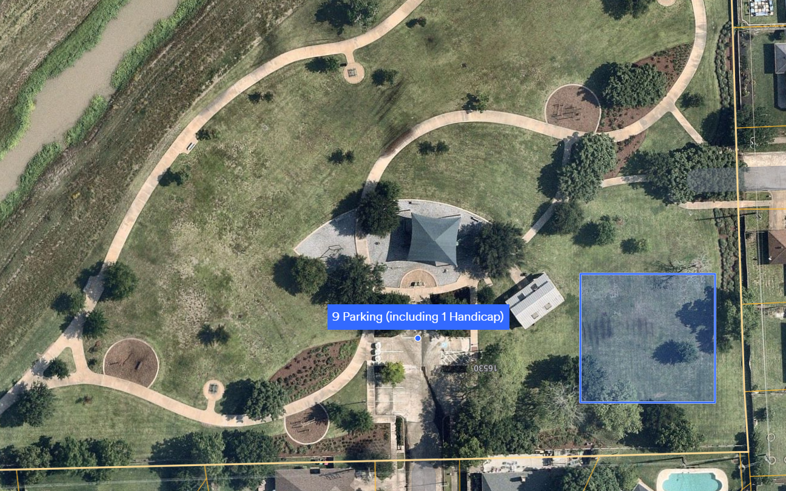
Possible Pickleball Facility
Duhacsek Park

Slide 5
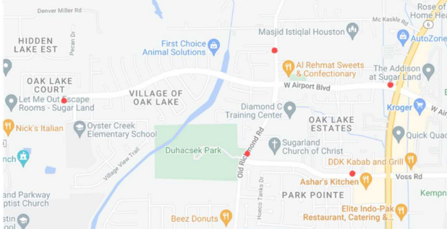
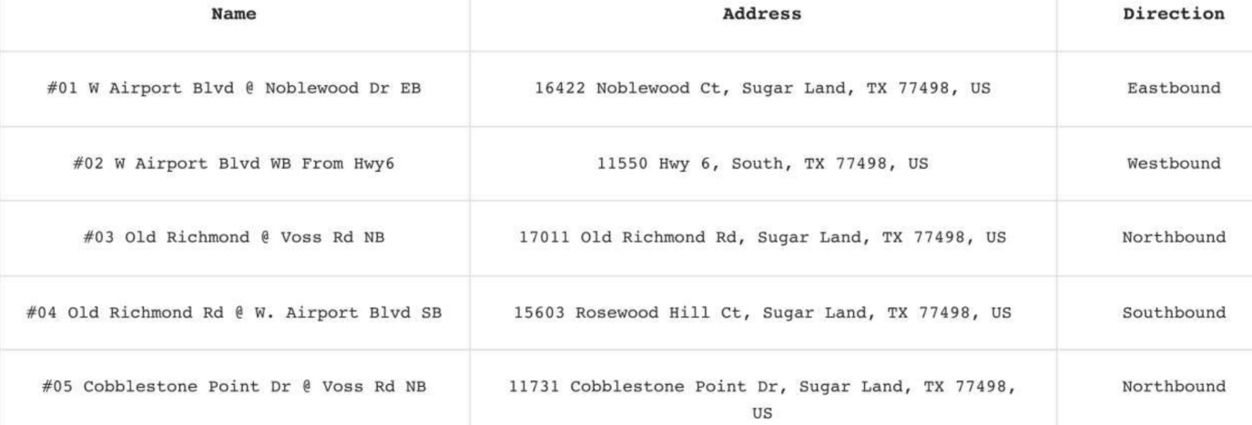
Flock Cameras

Slide 6
Flock Cameras

Slide 7
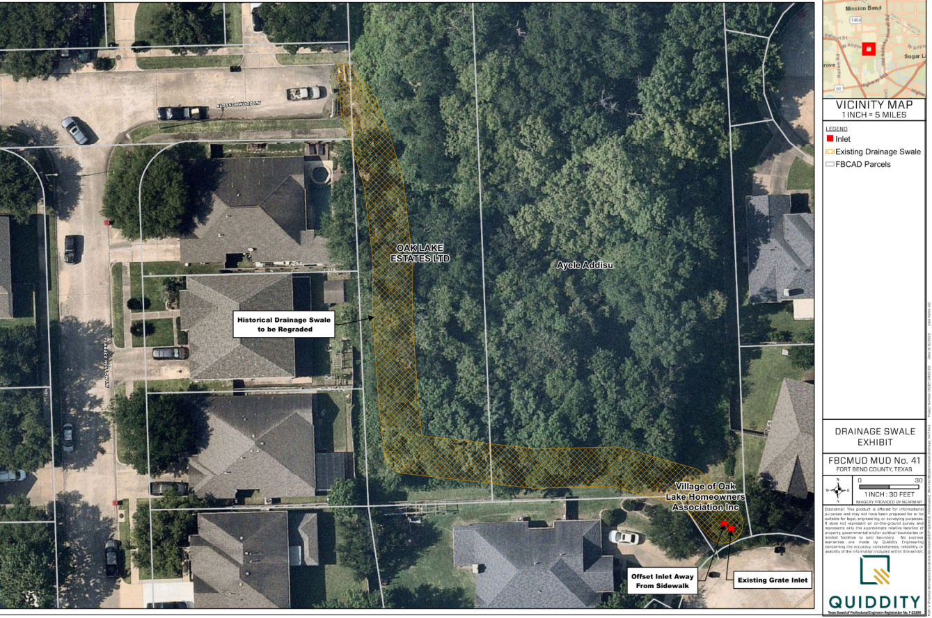
Blossomwood Lane Update

Slide 8
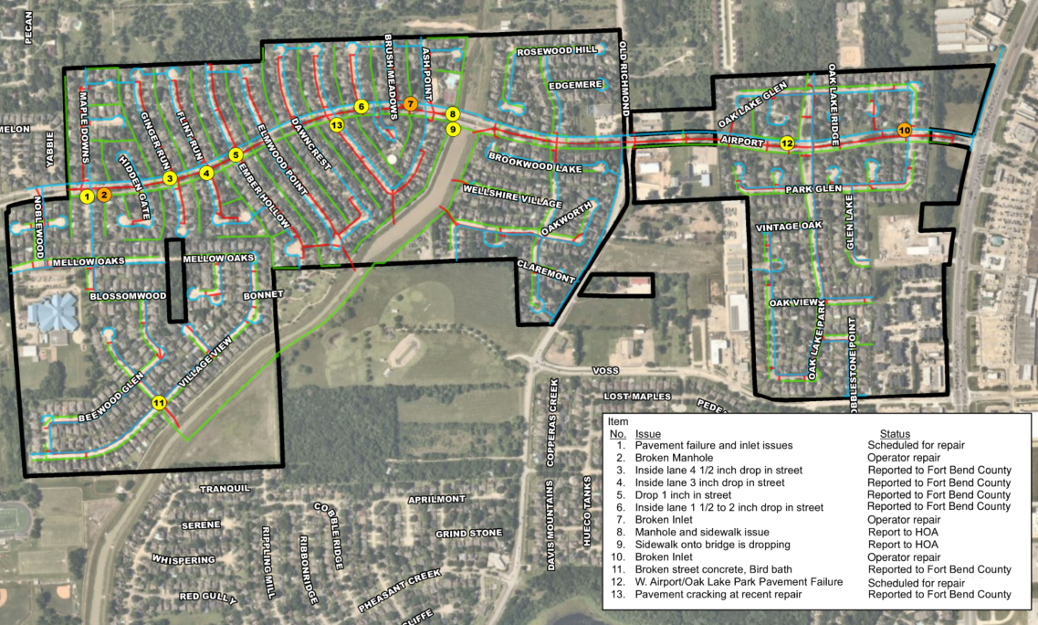
Requested Road Repairs

Slide 9
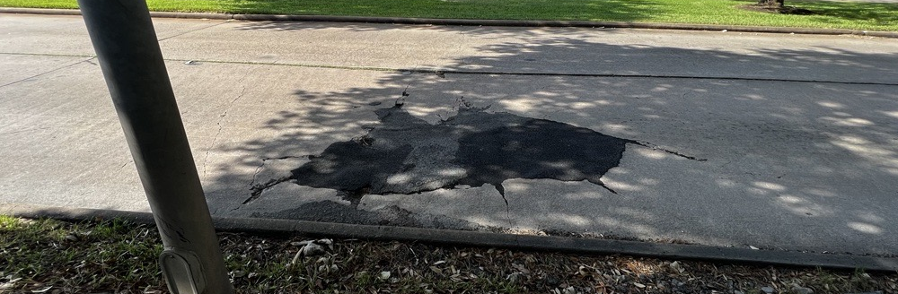
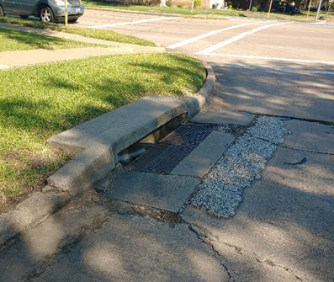
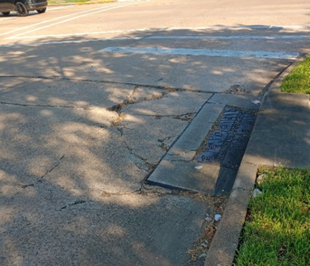
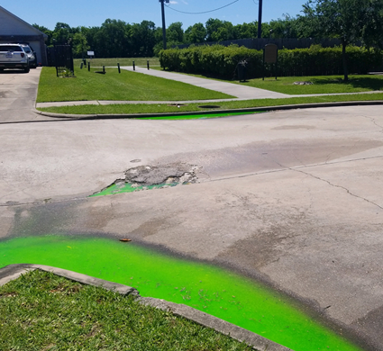
Requested Road Repairs

Slide 10
GFL Detention
Robert’s slide and update

Slide 11
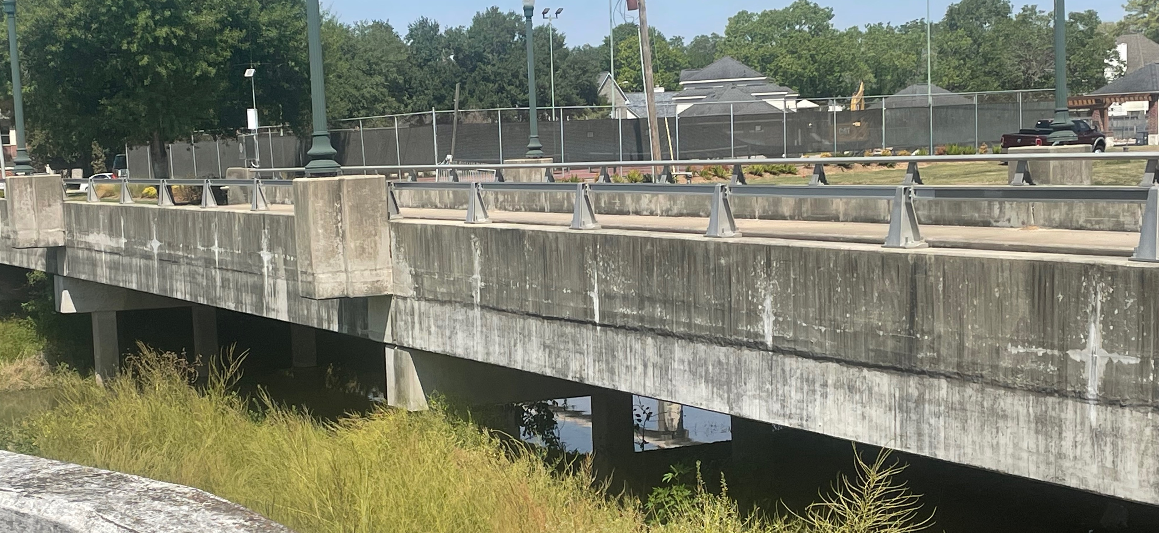
Red Gully Bridge

Slide 12
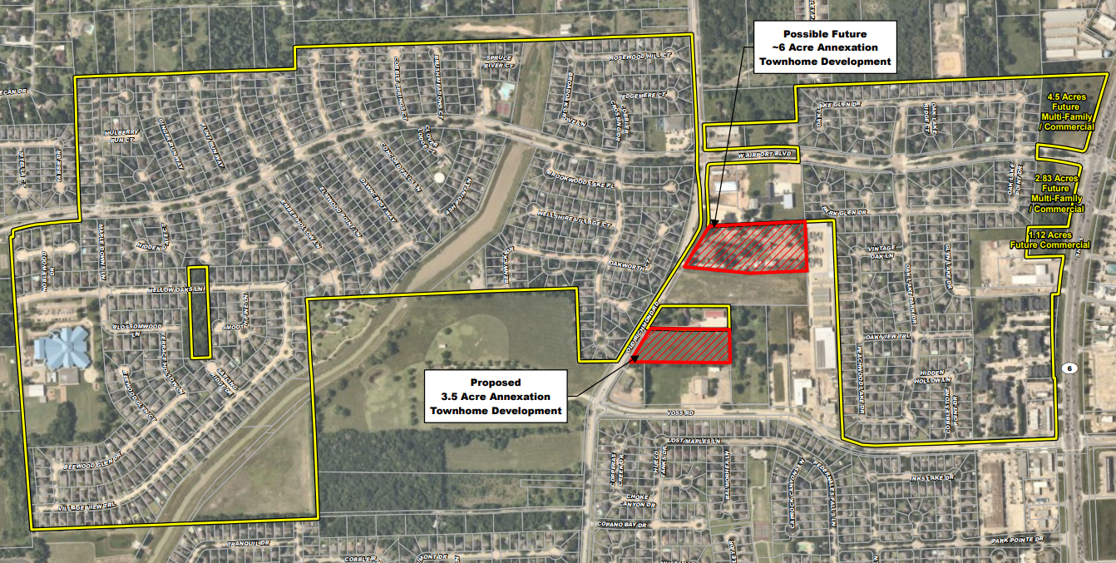
Oasis Annexation
Anticipated $18 Million
Future Assessed Value
Anticipated $12 Million
Future Assessed Value

Slide 13
Owais Annexation

Slide 14
Owais Annexation

Slide 15
Open Discussion
Notes:
Activity - 5 minutes
Break into twos
Introduce each other
Remember 2 adjectives
Then – stand and introduce each other to the room.
Then stnd and

